Slide 1
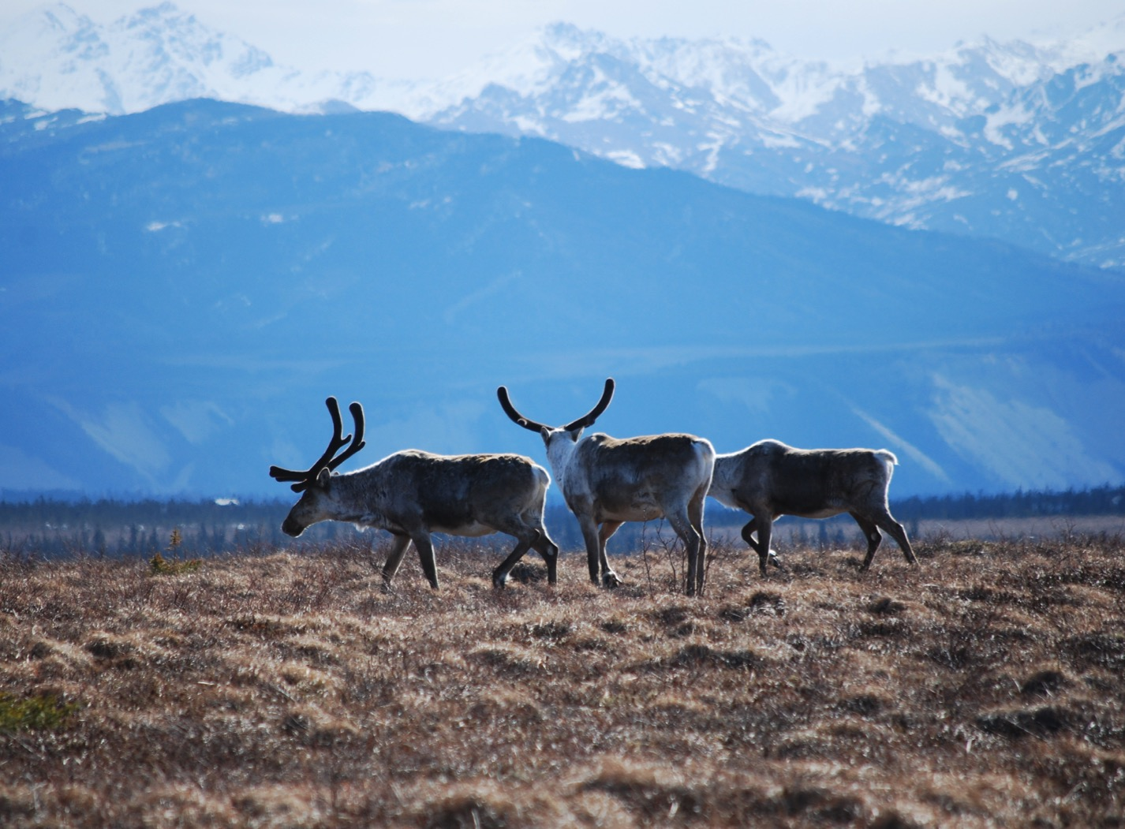
Arctic Boreal Vulnerability Experiment (ABoVE)
2017 ABoVE Airborne Campaign
7 June 2017 (DOY 158)
ATM-C: Inuvik – Fairbanks
Charles Miller, Deputy Science Lead
Jet Propulsion Laboratory, California Institute of Technology
and the ABoVE Science Team
For Hank Margolis, Eric Kasichke, Bruce Tagg
NASA HQ
Summer 2017

Slide 2
7 June 2017/DOY 158
Inuvik – Fairbanks
Assets Deployed:
Inuvik – ATM-C/Mooney (N617DH)/Atmospheric CO2, CH4, CO
Daily Summary:
All sensors operating nominally

Slide 3
7 June 2017/DOY 158
72-Hour Look Ahead
All plans weather dependent
Thursday 8 June 2017 (DOY 159):
Fairbanks – Bethel – Nome
Friday 9 June 2017 (DOY 160):
Nome – Barrow – Deadhorse – Fairbanks
Saturday 10 June 2017 (DOY 161):
Rest

Slide 4
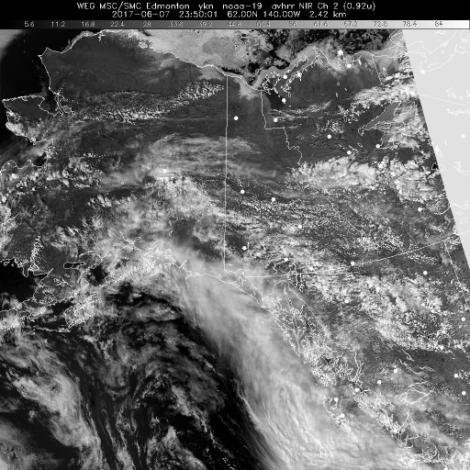
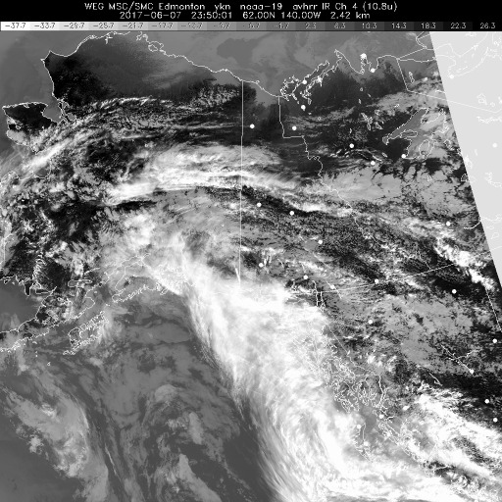
7 June 2017/DOY 158
Inuvik – Fairbanks
HRPT NIR
HRPT IR
HRPT Polar NIR (left) and IR (right) show clear to partly cloudy conditions from the Mackenzie Delta through the Yukon Flats to Fairbanks

Slide 5
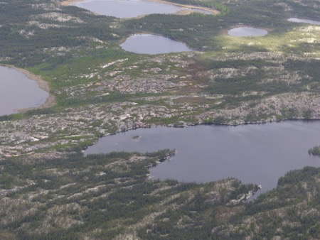
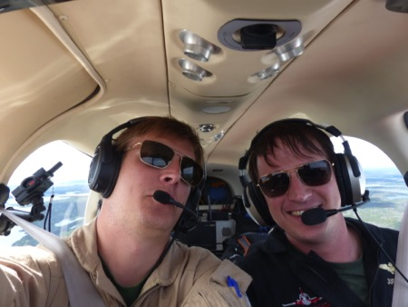
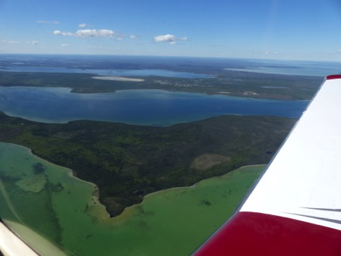
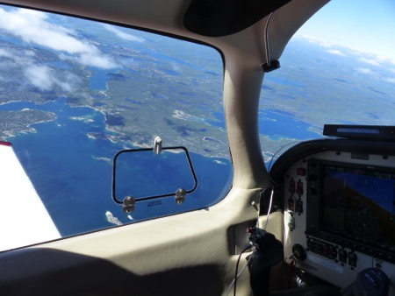
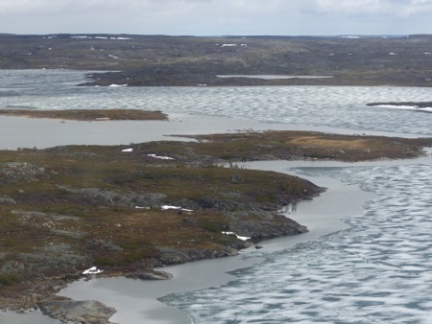
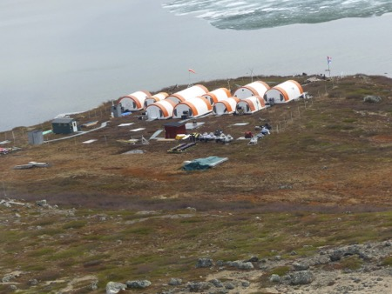
7 June 2017/DOY 158
Inuvik – Fairbanks
Stevens Village
The lakes and wetlands of the Mackenzie Delta, Old Crow Flats and the Yukon Flats

Slide 6
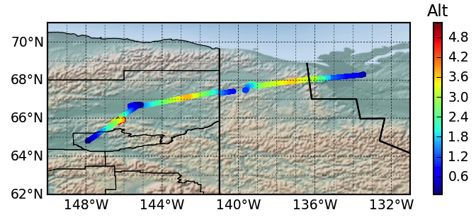
7 June 2017/DOY 158
Inuvik – Fairbanks
Flight Plan:
Inuvik – Old Crow – Fort Yukon – Fairbanks
Inuvik
Fort Yukon
Old Crow
Fairbanks
Notes:
Altitude minima @ (L to R) Fairbanks, Fort Yukon, Old Crow, Inuvik
Tundra Ecosystems: Inuvik, Old Crow
Boreal Forest: Fort Yukon, Fairbanks

Slide 7
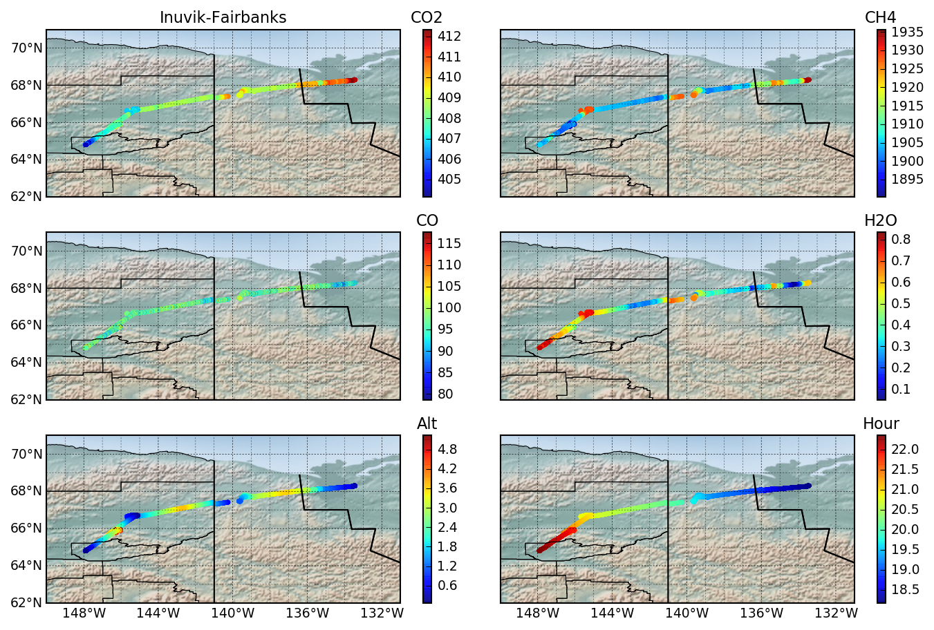
1 May 2017/DOY 122
Nome – North Slope – Fairbanks
Notes:
Lower left: Altitude minima @ (L to R) Fairbanks, Fort Yukon, Old Crow, Inuvik

Slide 8
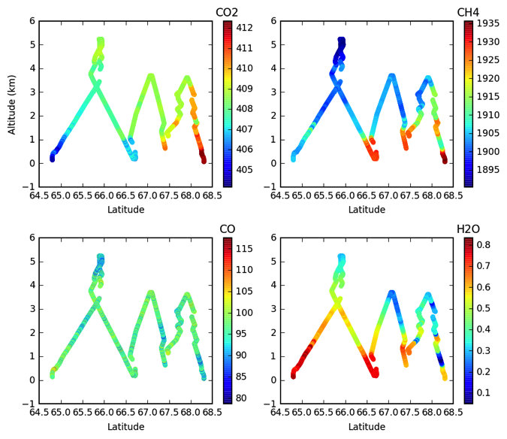
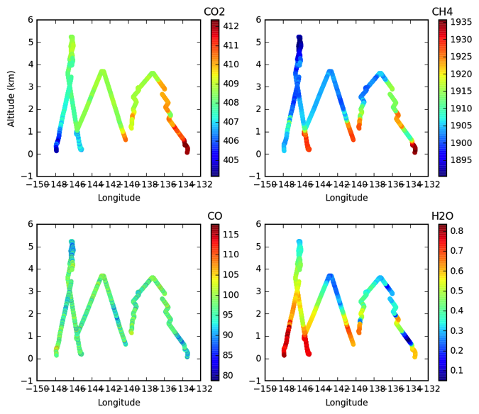
6 June 2017/DOY 157
Yellowknife – Daring Lake – Inuvik
CO2, CH4, CO, H2O profiles vs altitude and latitude (left) and longitude (right)
Small near surface (Z < 1 km) CO2 and CH4 enhancements in all locations
Largest near surface H2O observed 64-66 N and 165 W (furthest south and west)
Notes:
Left: Altitude minima @ (L to R/south to north) Fairbanks, Fort Yukon, Old Crow, Inuvik
+2-4 ppm CO2 enhancements observed over tundra ecosystems at Old Crow and Inuvik
-1-3 ppm CO2 depletions observed over the boreal forest ecosystems at Fort Yukon and Fairbanks
+2-4 ppm CO2 enhancements observed throughout the vertical profile over Inuvik
+20-30 ppb CH4 observed on all near surface dips except Fairbanks
RIGHT: Altitude minima @ (L to R/west to east) Fairbanks, Fort Yukon, Old Crow, Inuvik

Slide 9
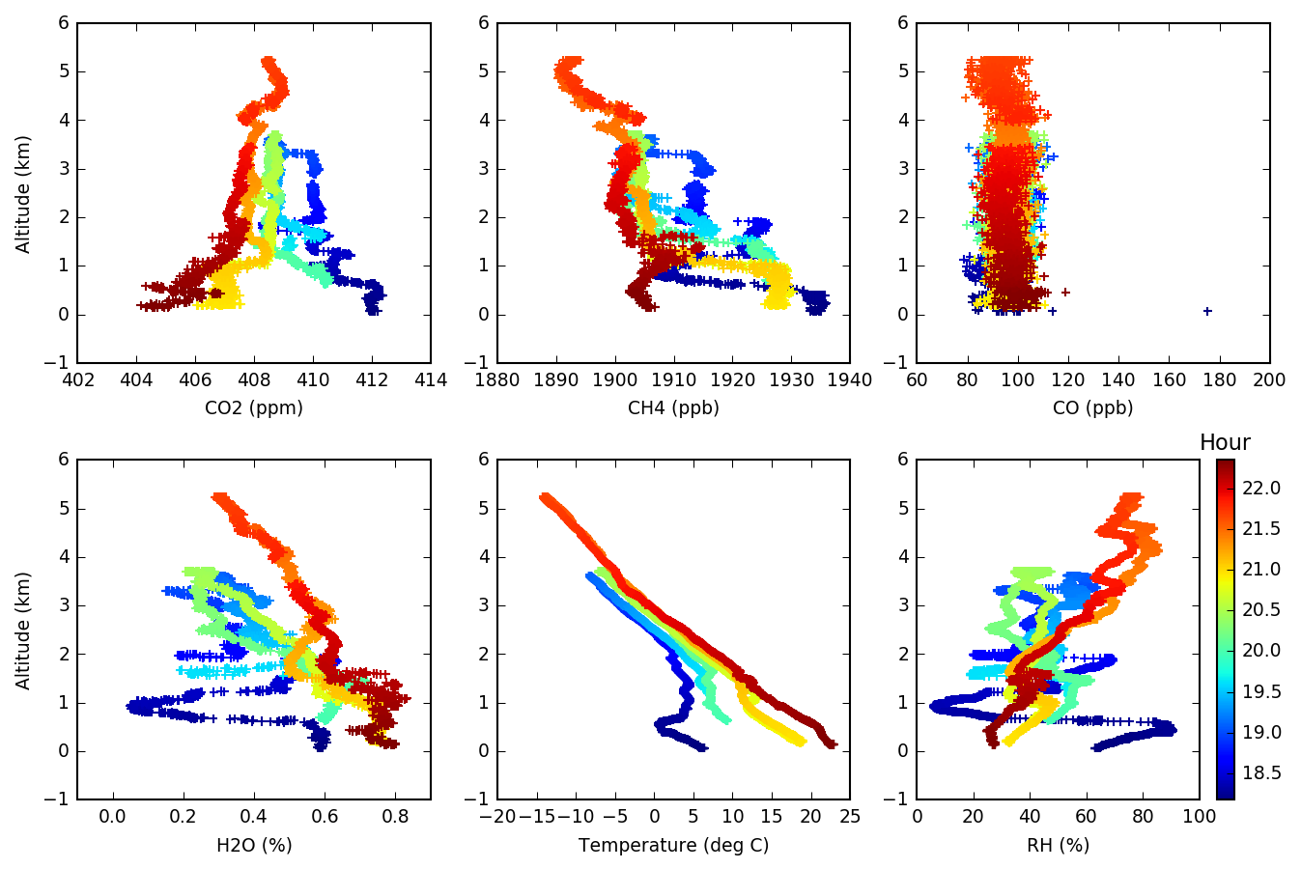
1 May 2017/DOY 122
Nome – North Slope – Fairbanks
Notes:
CO2 Profiles show near surface CO2 depletions at Fairbanks (red) and Fort Yukon (Yellow) but enhancements at Old Crow (light green) and Inuvik (dark blue)
Note that stronger near surface CO2 drawdown correlates with increasing temperature and near surface H2O%
CH4 profiles show 10-30 ppb CH4 enhancements for z < 1 km

Slide 10
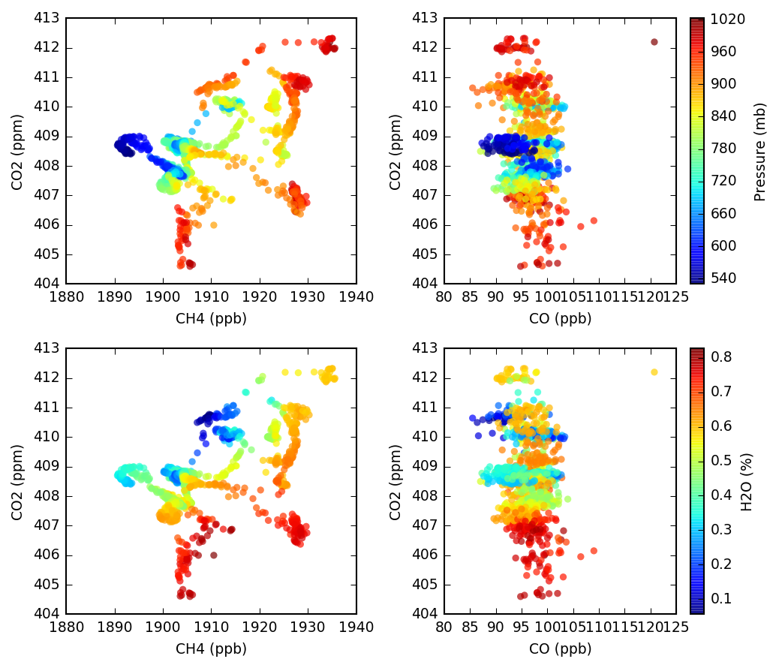
7 June 2017/DOY 158
Inuvik – Fairbanks
CO2 v CH4 and CO2 v CO tracer-tracer correlation plots with colors showing pressure altitude (top) and H2O (bottom)
Near surface CO2 v CH4 show evidence of both C release and C uptake
Largest CO2 depletions correlate with H2O > 0.70%
Largest CH4 enhancements tied less strongly to max H2O

